Slide 1

Managing Security Risk and Technical Debt
Richard Fennell
@richardfennell

Slide 2

The Why?

Slide 3






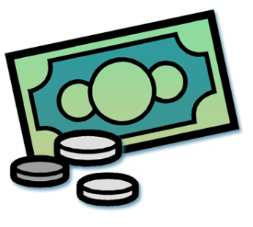

The Threat Landscape
Local Area Networks
First computer virus
Boot sector viruses
Create notoriety or cause havoc
Slow propagation
Internet Era
Macro viruses
Script viruses
Create notoriety or cause havoc
Faster propagation
Broadband prevalent
Spyware, Spam
Phishing
Botnets
Rootkits
Financial motivation
Internet wide impact
Peer to Peer
Social engineering
Application attacks
Financial motivation
Targeted attacks
Ransomware
1980s
1990s
2000s
2010s
Notes:
Ingress
Gain Beachhead
Install User Malware
Escalation of Privilege
Expand Presence
Redundant administrative access
Ongoing Surreptitious Remote Access
Implement Goals
Data Exfiltration
Other nefarious actions

Slide 4














Evolving Threats
Largest area by £ lost
National Interest
Spy
Personal Gain
Thief
Largest segment by £ spent on defense
Largest area by volume
Trespasser
Personal Fame
Fastest
growing
segment
Curiosity
Vandal
Author
Script-Kiddy
Undergraduate
Expert
Specialist

Slide 5
The What?
Overview

Slide 6
How does IT secure the Business?
Firewalls
Penetration Tests
The Result?
Only protect the boundary
Firewalls are only part of a solution
Organisations need to think more holistically
IT can only protect against what they know and if developers don’t tell them …..
Notes:
Do you trust stuff inside your network

Slide 7
The Problem is Software
“Malicious hackers don’t create security holes; they simply exploit them. Security holes and vulnerabilities – the real root cause of the problem – are the result of bad software design and implementation.”
John Viega & Gary McGraw

Slide 8
A word from the analysts
“75 percent of hacks happen at the application”
Gartner “Security at the Application Level”|
"The conclusion is unavoidable: any notion that security is a matter of simply protecting the network perimeter is hopelessly out of date”
IDC and Symantec
“If only 50 percent of software vulnerabilities were removed prior to production … costs would be reduced by 75 percent”
Gartner “Security at the Application Level”
“The battle between hackers and security professionals has moved from the network layer to the Web applications themselves"
Network World
“64 percent of developers are not confident in their ability to write secure applications”
Microsoft Developer Research

Slide 9





Trauma of Reactive Security
100X
Customers
In the Field
… the cost of fixing defects after deployment is almost fifteen times greater than detecting and eliminating them during development
15X
System/Acceptance
Testing
Integration Testing
6.5X
1 X
Static Analysis
Design
Development
Testing
Deployment
Source IDC and IBM Systems Sciences Institute

Slide 10
Cybersecurity Economics
Goal: Make Defenses cheaper/easier to achieve
Threat: Attacker tools always getting cheaper, more sophisticated
Due Diligence
Commercial Reasonability
Goal: Better defenses require attacks to be sophisticated (expensive and difficult) to be effective
Defender Benefit(D_{b})
Diminishing Returns
Defender Cost (D_{c})
Notes:
“A desired enterprise security state is the condition where the protection strategies for an organization's critical assets and business processes are commensurate with the organization's risk appetite and risk tolerances.” – CERT
Risk Appetite – defined through executive decision, influences amount of risk worth taking to achieve enterprise goals and missions
Relates to risks that must be mitigated and managed
Risk Tolerance – residual risk accepted
Relates to risk for which no mitigation would be in place

Slide 11
Ok So Why is Software Security poor?
Security is seen as something that gets in the way of software functionality.
Security is difficult to assess and quantify.
Security is often not a primary skill or interest of software developers.
Time spent on security is time not spent on adding new and interesting functionality.
We have (more than enough) security technologies
Notes:
We have (more than enough) security technologies, but we do not know how (and if) we are secure and we don’t know how to use them.

Slide 12


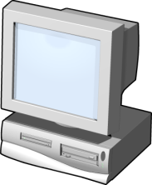
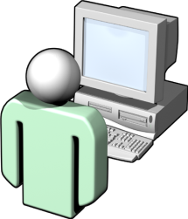


The What ? Theory - Summary
Attacker needs only one vulnerability
Defender needs to secure all entry points
Attackers have unlimited time
Defender has time and cost constraints
Attack v. Defend
Secure systems are more difficult to use
Complexity is difficult to remember
Users prefer simplicity and use
Security vs. Usability
Why the *&(^%$ do I need security?
Management doesn’t see business value
Developers find it makes more work
But addressing security just before release is very expensive
An Afterthought
Notes:
The challenges faced when implementing security include balancing the advantages that the attacker has over the defenders, and how the degree of security affect users, as well as conveying the message that security does add business value.
Attackers vs. Defenders:
The defender must protect all points; the attacker can choose the weakest point.
The defender must be constantly vigilant; the attacker can attack at any time.
Security vs. Usability:
Security can be taken to extremes, making the application too difficult to use. Secure developers should strive to make the system as secure as possible, but not to make it impossible to use.
Complex and strong passwords are those that must contain a mixture of uppercase and lowercase letters, and possibly punctuation characters. They must also be long – perhaps 9 or more characters in length.
However, there is often user resistance to strong passwords, because they are more difficult to remember. As soon as a user decides to write down a password so that they can remember it, your security is compromised.
Security As An Afterthought:
Security is often seen as a functionality disabler, as something that gets in the way. However, there is nothing more disabling than an attacker being able to get at your sensitive data. There is also a perception that the cost of implementing security is high and the business benefits are unclear. However, the cost of poor security can be very high, and in exceptional circumstances, could result in business failure.
Building security in from the start is essential to ensure a robust solution. If security is the last issue addressed, fixing of any security vulnerabilities that are discovered may break other product functionality, and in common with any other late changes in the product development cycle, it is much more expensive than if security is designed in in the first place.

Slide 13
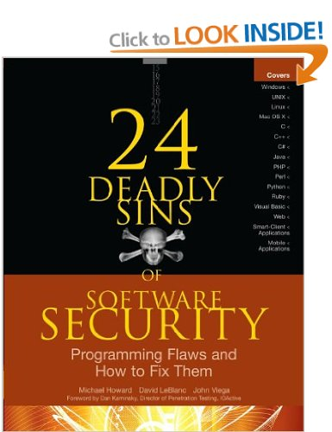
The What?
Classic Sins

Slide 14
Security Sins
Sin 0 Complacency
Sin 0.1 My Language/Run Time isn’t susceptible
Notes:
Michael Howard, David Leblanc and John Viega

Slide 15
Sin 1 : Buffer Overruns
Occurs when a program allows input to write beyond the end of the allocated buffer
Program might crash or allow attacker to gain control
Still possible in languages like C#, Java since they use libraries written in C/C++ but more unlikely
Cause is failing to validate input
Can occur on stacks and heaps

Slide 16
Common Buffer Overflow Myths
Myth #1: Buffer overflows only affect Microsoft platforms
Myth #2: Buffer overflows cannot exist in managed languages (e.g. .NET and Java)
Myth #3: Buffer overflows cannot be exploited on application heaps

Slide 17
Sin 4 : SQL Injection
Takes user input
Does not check user input for validity
Uses user input data to query a database
Uses string concatenation or string replacement to build the SQL query or uses the SQL Exec command
txtUserId = getRequestString("UserId"); txtSQL = "SELECT * FROM Users WHERE UserId = " + txtUserId;
SELECT * FROM Users WHERE UserId = 105 or 1=1

Slide 18
Common SQL Injection Myths
SQL injection applies only to applications that use Microsoft SQL Server
SQL injection applies only to Web-based applications
SQL injection can be remedied by using transport security protocols, such as SSL and IPSec
SQL injection only applies to non-authenticated users

Slide 19
Preventing SQL Injection
Validate input
Use SQL parameterized queries
Use stored procedures
Do not use “exec @sql” construct
Use SQL Execute-Only permission
strSQL=“SELECT IsAdmin from tblUSERS WHERE Username=@username AND password=@password”;
SQLCommand cmd= new SQLCommand(strSQL,connection);
cmd.Parameters.AddWithValue(“@username”,username);
cmd.Parameters.AddWithValue(“@password”,password);
Notes:
Filter any unallowable characters like ‘ or “”
mysql_real_escape_string($var)
Never use string concatenation to build SQL statements
Use stored procedures with parameters
C#:
cmd = new SqlCommand(queryName, sqlConn);
cmd.CommandType = CommandType.StoredProcedure;
cmd.Parameters.Add(“@ID”,Id);

Slide 20
Sin 7 : Cross Site Scripting
Somewhat misnamed, as crossing sites is not always necessary to exploit this bug
In a nutshell
Web app takes input from a user
Input is stored or echoed back to the user
That’s it
Notes:
Type 1: Non-Persistent
Often referred to as reflected cross-site scripting
Requires some level of social engineering
Type 2: Persistent
Often referred to as stored cross-site scripting
One attack can affect multiple users
October 2005: A cross-site scripting based worm infected over a million MySpace users within several hours of its release
Secure Computing Magazine, February 1, 2007
Cross-site scripting vulnerabilities were reported by the Open Web Application Security Project (OWASP) as the top Web-based vulnerabilities for 2007
OWASP 2007 Top 10

Slide 21



Type 1: Non-Persistent Cross-Site Scripting
Web Server
<html>
<head>
<title>Hello</title>
</head>
<body>
[malicious code]
</body>
…
Congratulations! You won a prize, please click here to claim your prize!
http://www.contoso.com?
id=[malicious code]
Malicious User
User
Notes:
Malicious user can inject script code that is then executed when another user views that page
Even if the input is merely echoed, a malicious user might:
Lure victim to their page
Get victim to click on a link which refers victim to the vulnerable site with the CSS bug
Script code is run under domain of the server and could get cookies or modify any elements of the DOM like tweak all links to point to porn sites

Slide 22
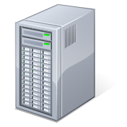


Type 2: Persistent Cross-Site Scripting
Malicious User
Web Server
Database
Blog Comment:
Hello, this article was helpful! [malicious code]
Thanks,
Kevin
Blog Comment:
Hello, this article was helpful! [malicious code]
Thanks,
Kevin
User
User
User

Slide 23
Common Cross-Site Scripting Myths
Myth - Cross-site scripting applies only to Web-based applications built on Microsoft technologies
Myth - Cross-site scripting can be remedied by using transport security protocols, such as SSL and IPsec

Slide 24
Sin 13 : Information Leakage
Attacker gets information, implicitly or explicitly, that could provide more information for the attacker to reach their goal
Examples:
Name of server software, versions
Debugging information (e.g. left on in PHP)
Error messages that reveal code structure

Slide 25
How?
Threat Modelling
Notes:
What are the Vunerabilities
How to mitigate them.

Slide 26
Terms
Threats: What a malicious user may attempt in order to compromise a system
Vulnerability: A defect in software that allows security policy to be violated.
Exploit: A program that exercises a vulnerability.
Threats and vulnerabilities are not the same thing:
Notes:
CVE: Common Vulnerabilities and Exposures : VUN DB
Confidentiality
Integrity
Availability
Security defects very easy to make
Blaster worm defect only two lines long
One line error can be catastrophic

Slide 27
Threat Modeling In a Nutshell
Vision
Model
Identify Threats
Mitigate
Validate
Product
Development
Notes:
A process to understand threats and vulnerabilities in an application
Can be used to find threats to a system early in the development process
Can be used by both security experts and non-security experts
Can be used to guide other security assessment activities
The threat modeling process should be driven by:
Application designers; however, developers and testers should be involved
What to thread model
The application as a whole
Security and privacy features
Features whose failures have security or privacy implications
Features that cross trust boundaries

Slide 28
STRIDE Threat Types
Desired Property | Threat | Definition
Authentication | Spoofing | Impersonating something or someone else
Integrity | Tampering | Modifying code or data without authorization
Non-repudiation | Repudiation | The ability to claim to have not performed some action against an application
Confidentiality | Information Disclosure | The exposure of information to unauthorized users
Availability | Denial of Service | The ability to deny or degrade a service to legitimate users
Authorization | Elevation of Privilege | The ability of a user to elevate their privileges with an application without authorization

Slide 29
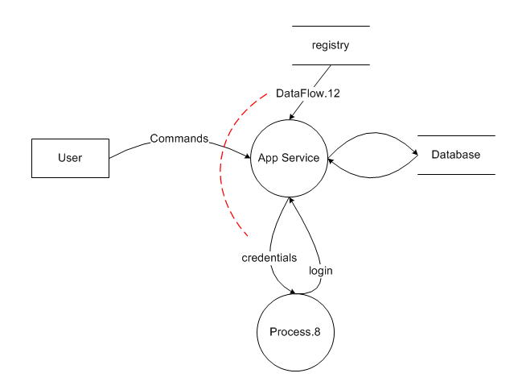
Threat Modeling Illustrated
Registry
T
R
I
D
S
Database Server
Application Service
Spoofing
Tampering
Repudiation
Information Disclosure
Denial of Service
Elevation of Privilege
E
Authentication / Authorization
Services
Notes:
Spoofing
Tampering
Repudiation
Information Disclosure
Denial of Service
Elevation of Privilege

Slide 30
Use DREAD to Prioritise Threats
 | Definition
Damage Potential | How great can the damage be?
Reproducibility | How easy is it to get the potential attack to work?
Exploitability | How much effort and experience is required to mount the attack?
Affected Users | If the threat were exploited, how many users will be effected?
Discoverability | The probability the threat will be found
Risk_{DREAD}: (D + R + E + A + D) / 5
Notes:
Rank each item 0 to 10 and then calculate the Risk
This allows prioritisation of risk

Slide 31
How? Threat Modelling - Summary
Perform regular threat modelling
Use a consistent process
Prioritise actions based on the business view to risk

Slide 32
How?
Mitigations

Slide 33
Mitigations
Approaches to threat mitigation (in order of preference):
Redesign
Use standard mitigations
Use unique mitigations
Accept risk in accordance with policies
Notes:
To address identified threats to an application design

Slide 34
Examples of Standard Mitigations
Threat | Example Standard Mitigations
Spoofing | IPsec Digital signatures Message authentication codes Hashes
Tampering | ACLs Digital signatures Message Authentication Codes
Repudiation | Strong Authentication Secure logging and auditing
Information Disclosure | Encryption ACLs
Denial of Service | ACLs Quotas High availability designs
Elevation of Privilege | ACLs Group or role membership Input validation

Slide 35
Attack Surface Reduction
Attack Surface: Any part of an application that is accessible by a human or another program
Each one of these can be potentially exploited by a malicious user
Attack Surface Reduction: Minimize the number of exposed attack surface points a malicious user can discover and attempt to exploit

Slide 36
Defense In Depth
Assume that software and hardware will fail at some point
Trusted applications: security and privacy features and mechanisms
To many applications today can be compromised when single, and often only, layer of defense is breached (firewall)
If one defense layer is breached, what other defense layers (if any) provide additional protection to the application?

Slide 37
Least Privilege
Assume that all applications can and will be compromised
If an application is compromised, then the potential damage that the malicious person can inflict is contained and minimized accordingly
Notes:
Evaluate your application and think minimally!
What is the minimum access level your application requires to perform its functions?
Elevate privileges only when needed, and then release those elevated privileges when their purposes have been satisfied

Slide 38
Secure Defaults
Deploy applications in more secure configurations by default.
Helps to better ensure that customers get safer experience with your application out of the box, not after extensive configuration
It is up to the user to reduce security and privacy levels

Slide 39
Input Validation Tips
“All input is evil, until proven otherwise”
Validate input that crosses trust boundaries
Validate inputs against expected data:
Format
Length
Type
Range

Slide 40
Compiler Defenses
Run-time defenses mostly from buffer overflows and other malicious attempts to control execution flow
Defensive code is automatically added by compiler, not developer
Compiler defenses do not fix security vulnerabilities
Should not be considered a “silver bullet”

Slide 41
Banned APIs
Incorrect use can lead to serious vulnerabilities
Effective way to help reduce risk
The Microsoft SDL Banned APIs list is not a static list
Also applicable to non-Microsoft platforms
Useful when source code is available
https://msdn.microsoft.com/en-us/library/bb288454.aspx
Notes:
Microsoft SDL Banned APIs: A documented list of function calls and libraries that are prohibited for use by new applications and legacy applications.

Slide 42
Not All Cryptographic Standards Are Safe!
Banned by Microsoft SDL for all new applications:
MD4, MD5, RC4, DES, SHA1
Approved by Microsoft SDL for all new applications:
Advanced Encryption Standard (AES) or Rijndael
SHA 256 or higher

Slide 43
How?
Testing and Analysis

Slide 44

Functional Testing vs. Secure Testing
Intended Functionality
Actual Functionality

Slide 45
How Experts view Secure Testing
“The symptoms of security vulnerabilities are very different from those of traditional bugs”
“How To Break Software Security”
“The designers and the specifications might outline a secure design, the developers might be diligent and write secure code, but it’s the testing process that determines whether the product is secure in the real world”
“Writing Secure Code, Second Edition”

Slide 46
Security Testing Tips
Single Rule of Security Testing: there are no rules!
“Malicious users wouldn’t try to do that” - Yes they will!
Malicious users will try to circumvent application client components
Malicious users will try to compromise application dependencies

Slide 47
Penetration Testing
Goal is to simulate actual attacks against an application and measure how well the application is able to withstand such attacks
Attack the application as a malicious user by using:
Manual techniques
Attack tools
Penetration testing provides a security posture snapshot only at the specific time of testing

Slide 48
Code Review
Manual review of the source code of an application to identify common code weaknesses
Context-aware analysis
Should be performed for all high-priority code
Very effective, but also very labor-intensive
Automation tools to assist code reviewers are available
Notes:
Security code reviews are not meant to replace other assessment activities, and certainly is not to be considered a “silver bullet”

Slide 49
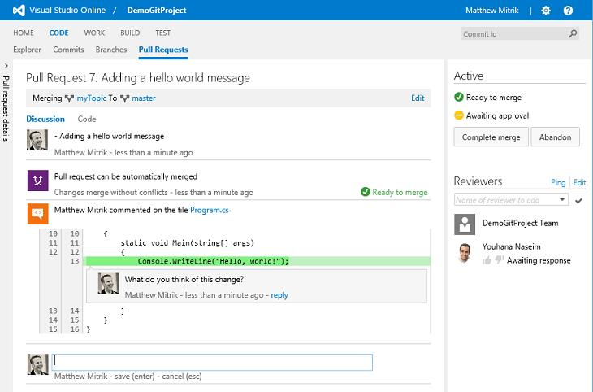

Slide 50
Release Management
Make sure settings and configurations are correctly secured.
Use automation where possible
Have an incident response plan ready
Keep a release archive
Notes:
Audit: checklist, incident response plan completed, release archive available.

Slide 51
Incident Response
Minimize response time for an active incident to the time to execute response plan
Update planning with a retrospective
What worked?
What didn’t work?
What should we do next time?
THIS IS TOO OFTEN FORGOTTEN…
Notes:
Audit: all steps implemented? What worked? What didn’t work? After-action report.

Slide 52
Implementing SDL in VSTS

Slide 53
Is there a TFS SDL Template?
No, there isn’t one….
You need to grow your own. Key features will be…
A means to mark issues/features as security related
Potentially automated work item creation on events, or tools to generate work upon demand e.g. start of sprint
Thread model session for new features
Secure Code reviews
Static analysis in automated build

Slide 54
The first layer - Visual Studio
Use the built in tools for the first layer of protection
Unit-Testing
Code Analysis (FxCop)
StyleCop
SonarLint (VS 2015 and later)

Slide 55
The second layer – VSTS/TFS
Combined Visual Studio with VSTS or TFS
Continuous Integration
Code Review via Pull Requests if using Git
Gated Checkin if using TFVC
SonarQube integration

Slide 56

Introducing SonarQube
To quote the product homepage…
“The SonarQube® platform is an open source quality management platform, dedicated to continuously analyzing and measuring the technical quality of source code, from project portfolio down to the method level. To understand what the platform tracks and why it's important, take a look at the Developers' Seven Deadly Sins.”
Notes:
Popular in the Open Source space, used to be called Sonar

Slide 57
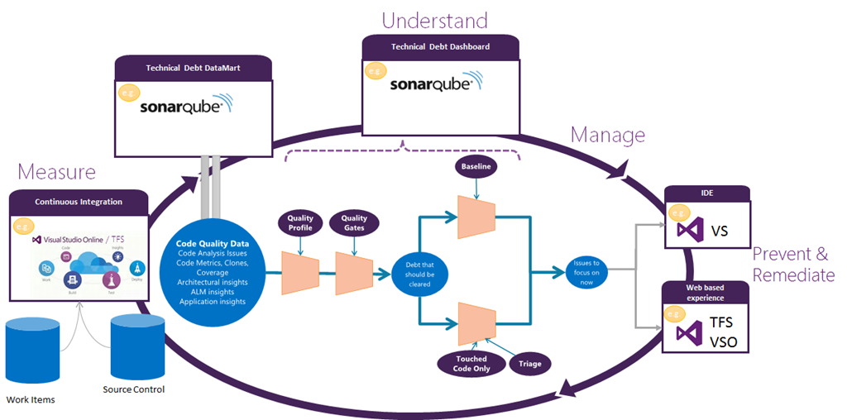
Notes:
How Microsoft see it fitting in

Slide 58
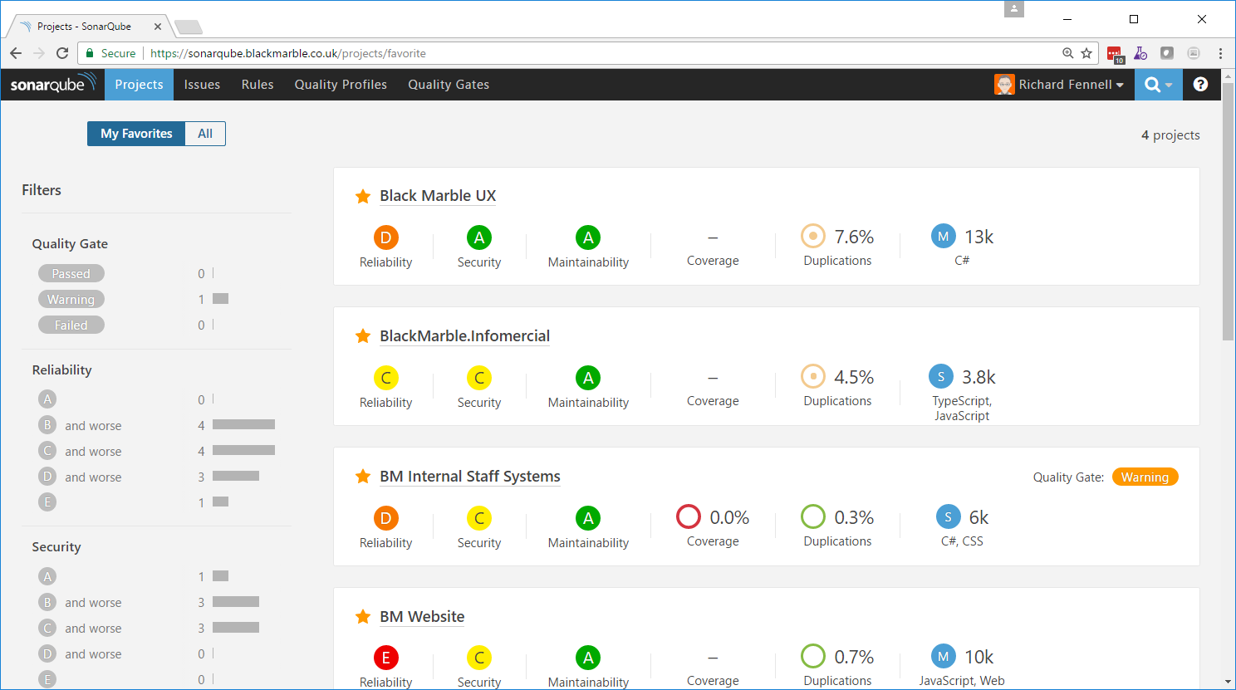

Slide 59
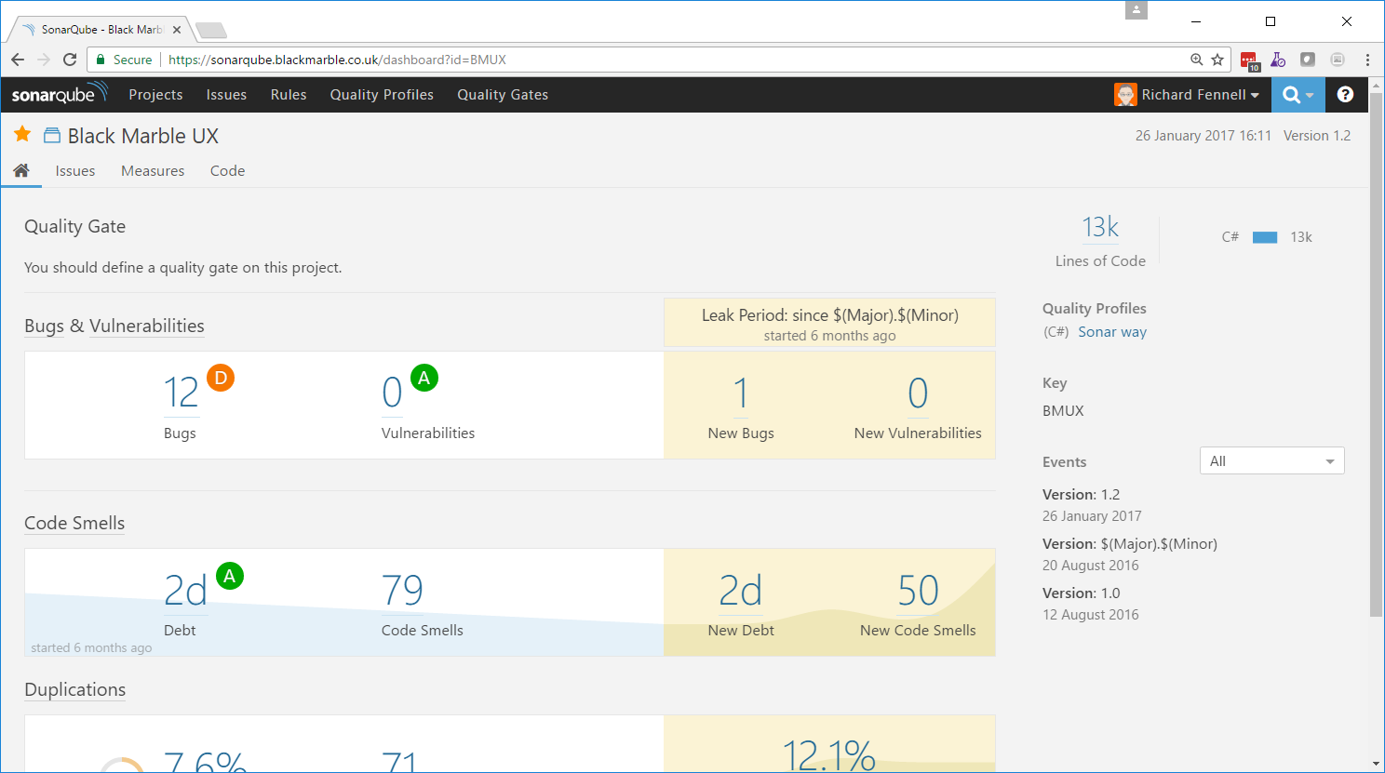

Slide 60
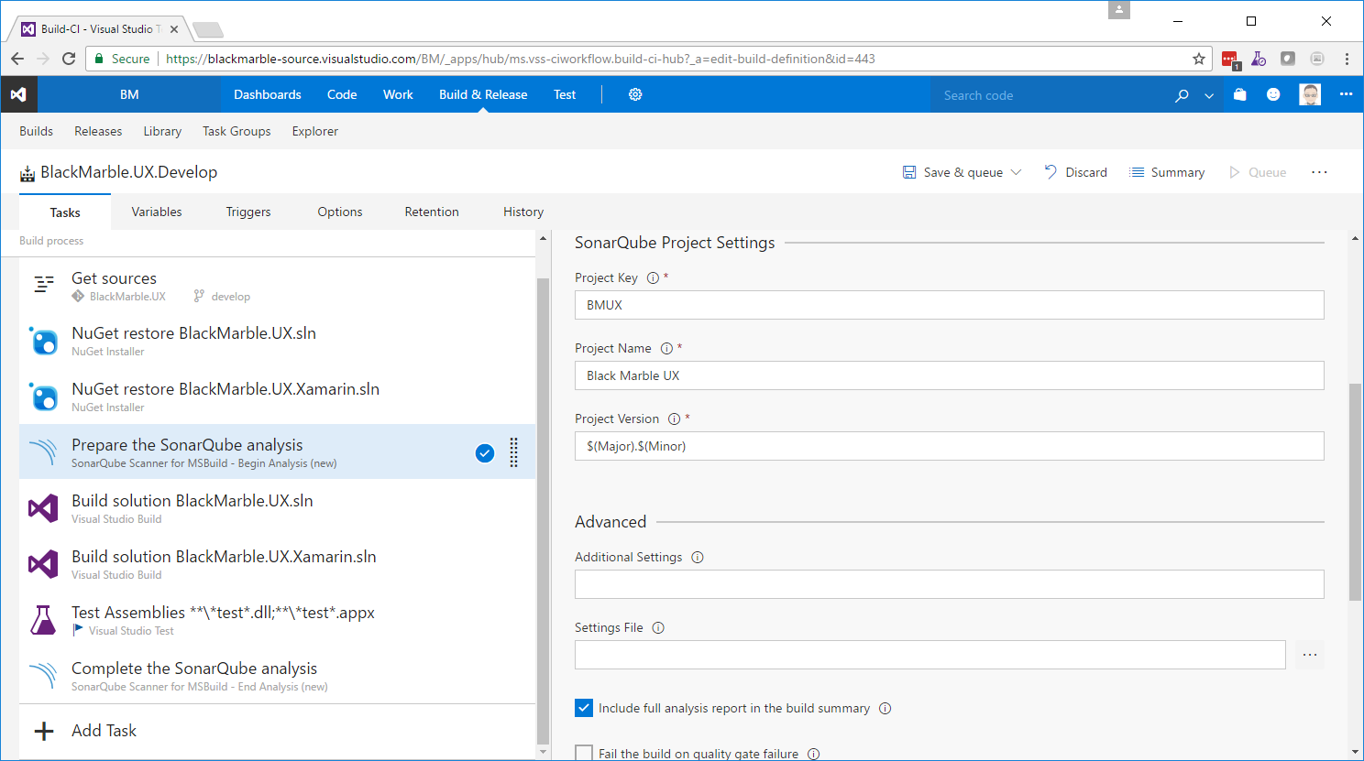

Slide 61
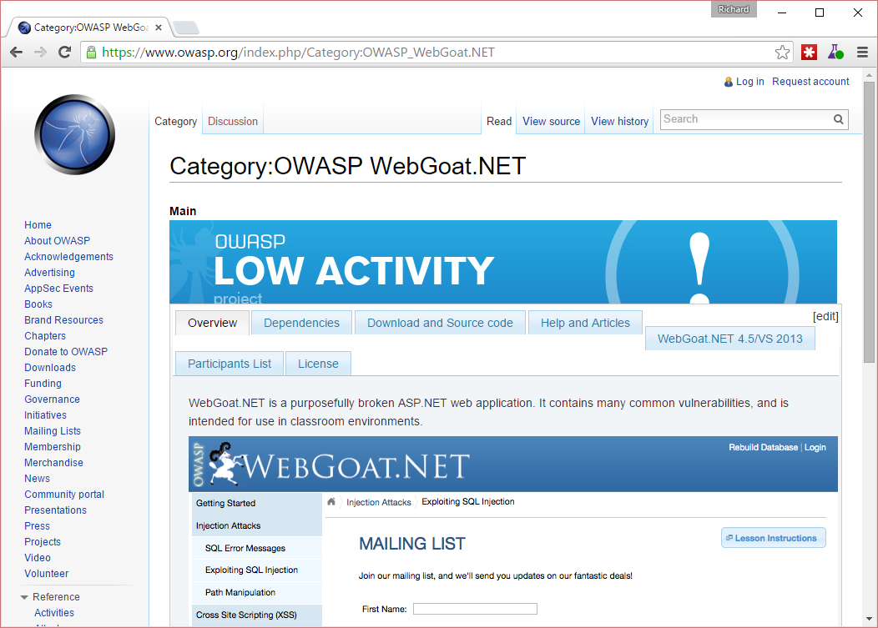
Whatever your process you need to test it
Have a sample that tests your process find issues
OWASP Open Web Application Security Project - WebGoat Bad Bank
Useful to provide processes during audit

Slide 62
Summary
If you wait until an application is already in production to make it secure, you are too late
Develop a thoroughly considered policy exception tracking process
Education is crucial to the success of a security program
Security is an ongoing, always changing concern
Threat model your work!
Start early
Track changes
Notes:
Good security practices take into account both the host and the application client
Create clearly written and easily accessible security guideline documentation
Create security checklists that include step-by-step instructions

Slide 63
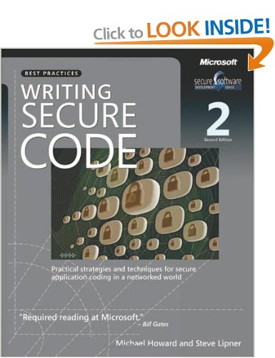
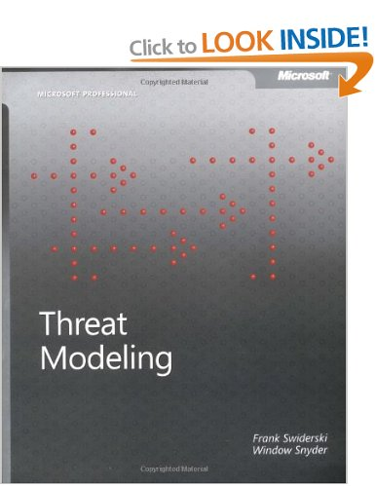
Books to read

Slide 64
Resources
Open Web Application Security Project (OWASP)
https://www.owasp.org
SonarQube
http://www.sonarqube.org
Microsoft ‘Writing Secure Code’
https://msdn.microsoft.com/en-us/security/aa570401.aspx
Microsoft ‘The Trustworthy Computing Security Development Lifecycle’
https://msdn.microsoft.com/en-us/library/ms995349.aspx

Slide 65
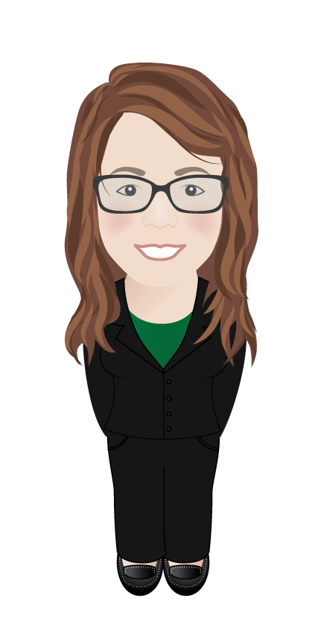
Call to Action
Black Marble SDLC Consultancy
Bespoke On-site Workshops: Assess your current situation and needs
Technology Demonstrator: Deploy the tools for you to use
Ongoing Consultany: Automate your own projects and build best-practice
*Length varies based on scale and ALM/DevOps maturity

